Slide 1
Data Science Engineering Methods and Tools Lecture 12
Northeastern University
College of Engineering
INFO 6105 – Spring 2024
Abdolreza Mosaddegh

Slide 2
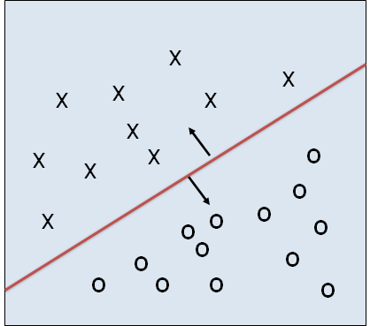
Support Vector Machine (SVM)
Support vector machines (SVMs) are a set of supervised learning methods used for classification and regression. It can be employed for both linear and nonlinear classifications. SVM finds the best separating line (or plane or hyperplane) for classification.
The line shows the decision boundary:
The data above the red line belongs to class ‘x’
The data below red line belongs to class ‘o’
f (x_{i} ) ≥ 0 ⇒ y_{i} = 1
f (x_{i} ) < 0 ⇒ y_{i} = −1

Slide 3
Selection of Separating Hyperplane
Which line (or plane or hyperplane) is the best?
Var₁
Criterion (objective function) for selection best hyperplane :
SVM finds hyperplane that maximizes separability of classes
Var₂

Slide 4
Maximizing the Margin
Which hyperplane maximizes separability of classes?
SVM selects the separating hyperplane that maximizes the margin
Var₁
Margin Width
Margin Width
Var₂

Slide 5
Support Vectors
Training set is effectively reduced to a relatively small number of support vectors
Var₁
Support Vectors
If all other training examples (besides support vectors) are removed and the training is repeated, the same separating hyperplane would be found
Margin Width
Var₂

Slide 6
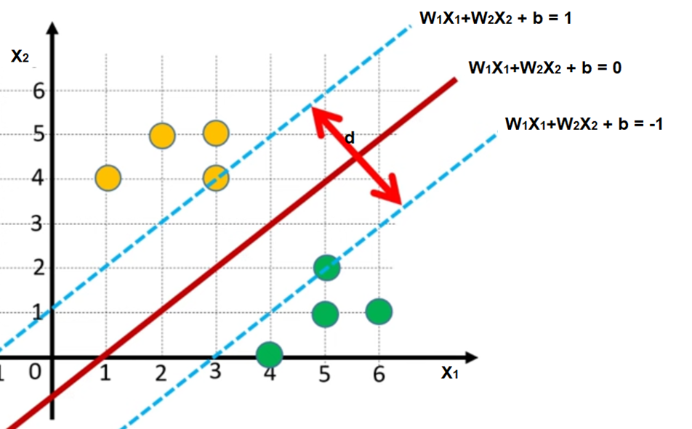
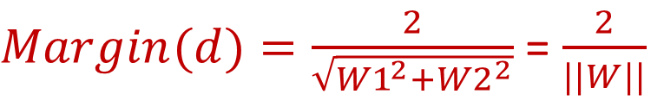
Maximizing the Margin
X1
[w1 w2]
+ b = 0
X2
w^{T} x + b =0
Decision boundaries for a training set {(x_{i} ,y_{i})}
w^{T}x_{i} + b ≥ 1
w^{T}x_{i} + b ≤ -1
if y_{i} = 1 (class yellow)
if y_{i} = -1 (class green)
$Margin(d)=\frac{2}{\sqrt{{W1}^{2}{+W2}^{2}}}$ = $\frac{2}{||W||}$
We can summarize two formulas as :
y_{i} (w^{T}x_{i} + b) ≥ 1

Slide 7
Training SVM
Training process is an optimization problem.
We can formulate the optimization problem as:
Find w and b such that
2
ρ =
is maximized and for all {(x_{i} ,y_{i})}
w
w^{T}x_{i} + b ≥ 1 if y_{i}=1; w^{T}x_{i} + b ≤ -1 if y_{i} = -1
A better formulation:
Find w and b such that
||w|| is minimized and for {(x_{i} ,y_{i})}
y_{i} (w^{T}x_{i} + b) ≥ 1
We can formulate a quadratic optimization problem to maximize a quadratic function of some real-valued variables subject to linear constraints which can be solved in many ways.

Slide 8
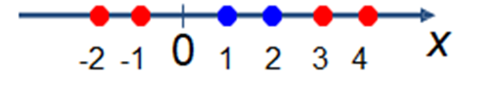
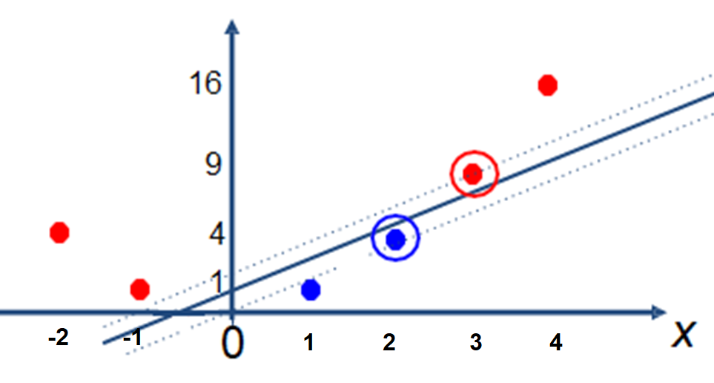
Non-linear SVMs
Data is not linearly separable:
Solution: mapping data to a new feature space that data are linearly separable
_{x}2

Slide 9

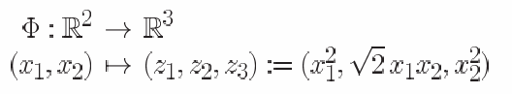
Non-linear SVM: Mapping into New Feature spaces
The original feature space can always be mapped to some higher-dimensional feature space (using function called Kernel functions) where the training set is separable:

Slide 10
Examples of Kernel Functions
Linear: K(x_{i},x_{j})= x_{i} ^{T}x_{j}
Polynomial of power p: K(x_{i},x_{j})= (1+ x_{i} ^{T}x_{j})^{p}
x_{i} −x_{j}
2
−
RBF (radial-basis function network): K(x ,x )= ^{e}
2σ ²
i j
Two-layer perceptron: K(x_{i},x_{j})= tanh(β₀x_{i} ^{T}x_{j} + β₁)

Slide 11
SVM
Advantages
Prediction accuracy is generally high
Robust, works well when training examples contain a few noises
Few Hyper-parameters (Linear SVM)
Amenable to new kernel function
Disadvantages
Long training time
Difficult to interpret the results especially if kernels are used (black-box)
Need to choose the kernel and tune its parameters for Non-leaner SVM

Slide 12
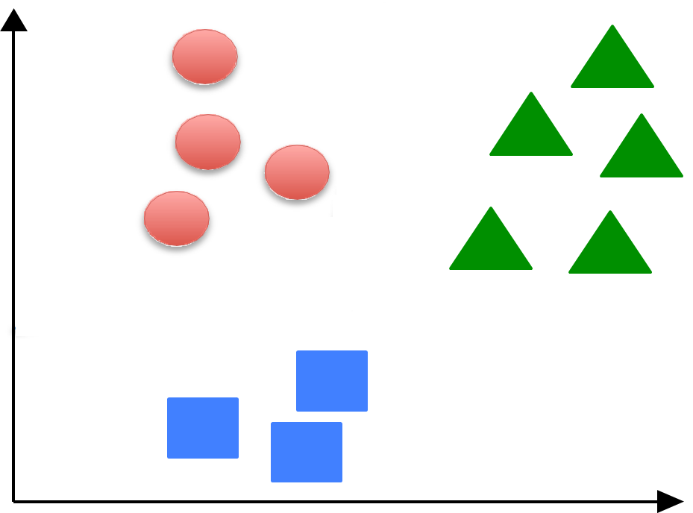
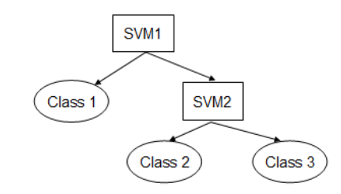
Multi‐Class Classification - Sequential
1- Find a hyperplane to separate class 1 from other classes (classes 2 and 3)
2- Find another hyperplane to separate class 2 from remaining classes (class 3)
3- …
Class2
Class1
Class3

Slide 13
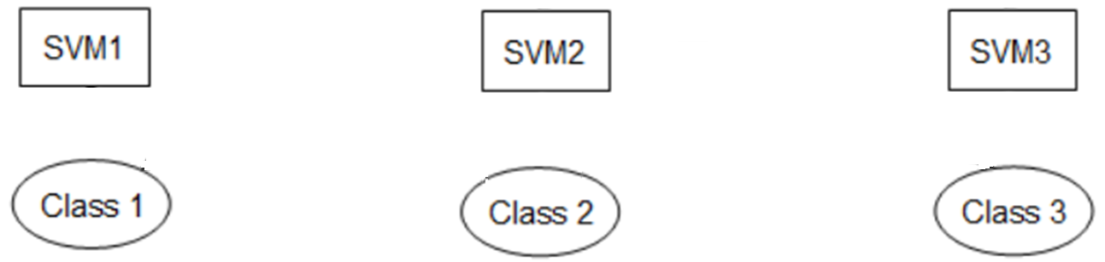
Multi‐Class Classification - Parallel
Train multiple SVM models each one separate one class from other classes
Class2
Class1
Class3

Slide 14
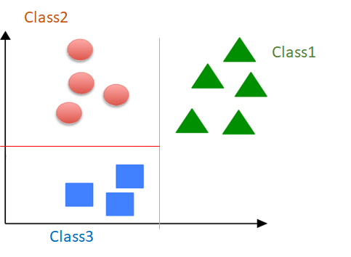
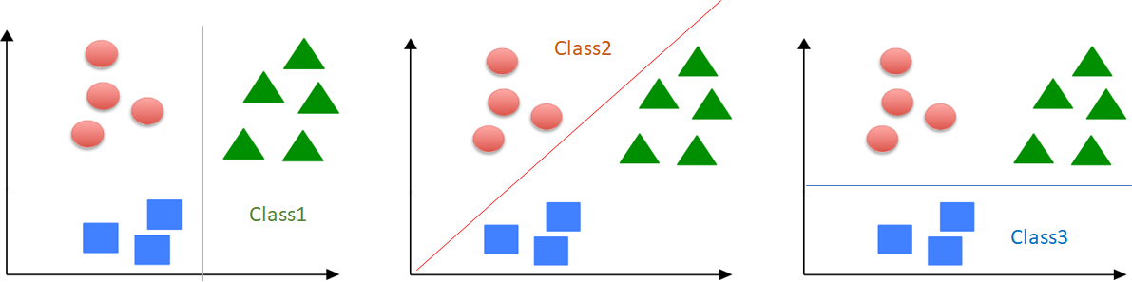
Parallel vs Sequential Processing
Sequential: Optimized for single-threaded processing
Parallel: Optimized for multi-threaded processing

Slide 15
Parallel Processing in Big Data
Advanced AI techniques requires a massive scale of data to learn and improve models.
Big data refers to data that are too large or complex to be dealt with by traditional data-processing approaches. Big data is where parallel processing is needed to handle data
New generations of GPUs with thousands of cores provide strong capabilities of parallel processing for large-scale Big Data analytics

Slide 16
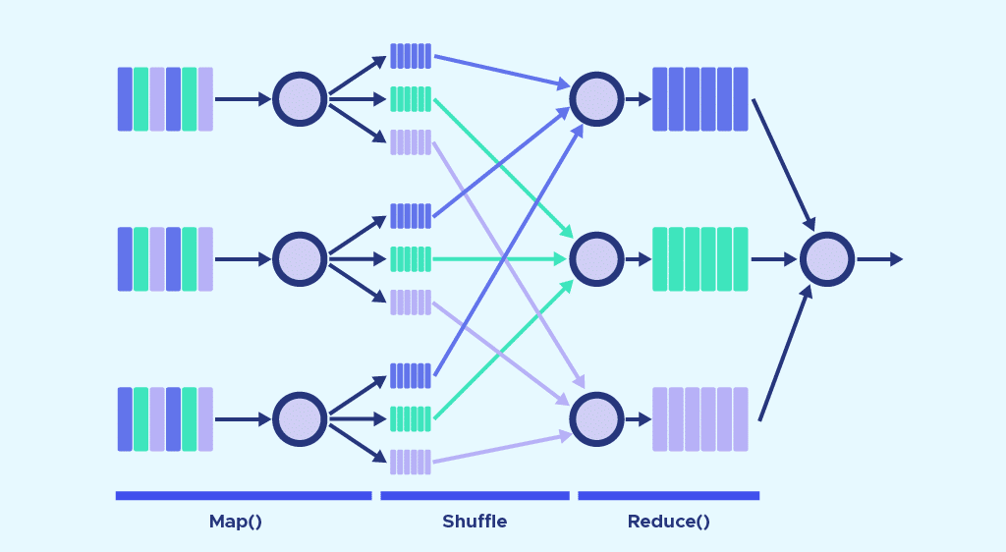
MapReduce
A parallel processing framework that can be applied to many large-scale computing problems including machine learning models
Pioneered by Google and popularized by Hadoop and Spark platforms
Handle parallel processing details and simplifies large-scale computations
Automatic parallelization
Speed up applications by employing more cores / threads in parallel
Automatic handing of machine failures

Slide 17
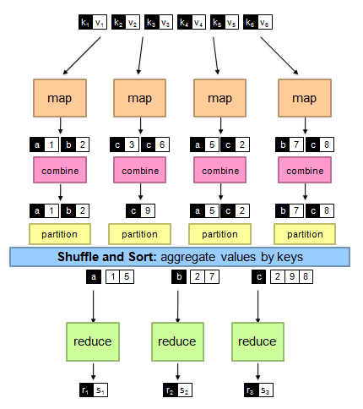
MapReduce Steps
Read input data
Map: extract key-value pairs
(Hidden) shuffle and sort
Reduce: aggregate, summarize, or transform values for each key
Produce outputs
Map
(k, v) → <(k₁, v₁), (k₂, v₂), (k₃, v₃), ……, (k_{n}, v_{n})>
Reduce
(k’, <v’₁, v’₂, ……, v’_{n}>) → <(k’, v”₁), (k’, v”₂), ……, (k’, v”_{m})>
All v’ with the same k’ are reduced together

Slide 18
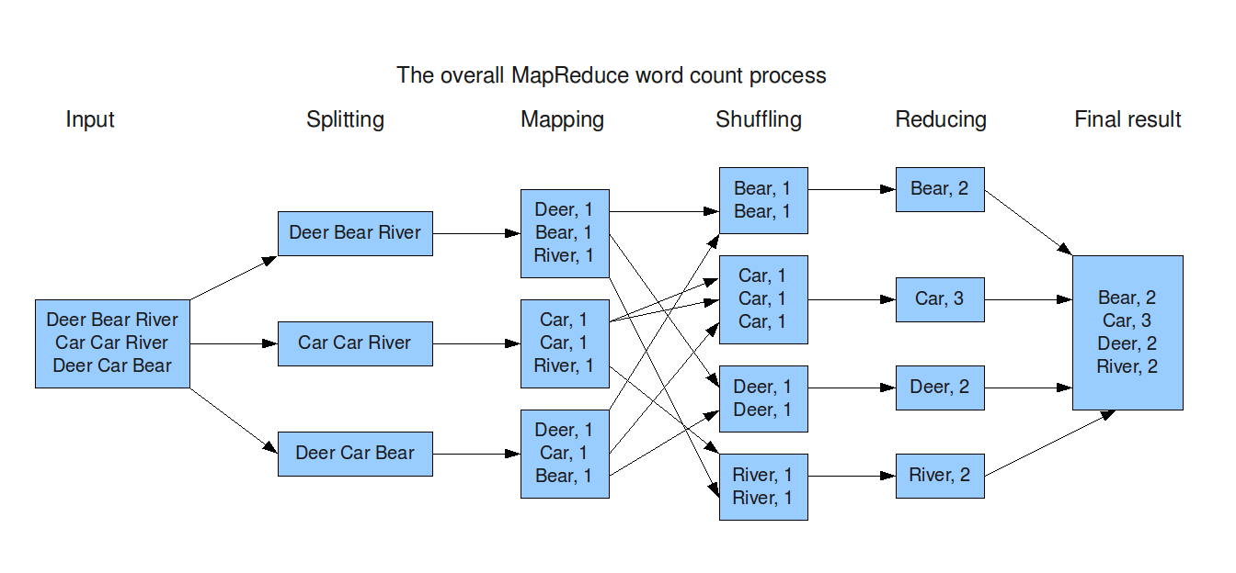
Map-reduce - Example

Slide 19
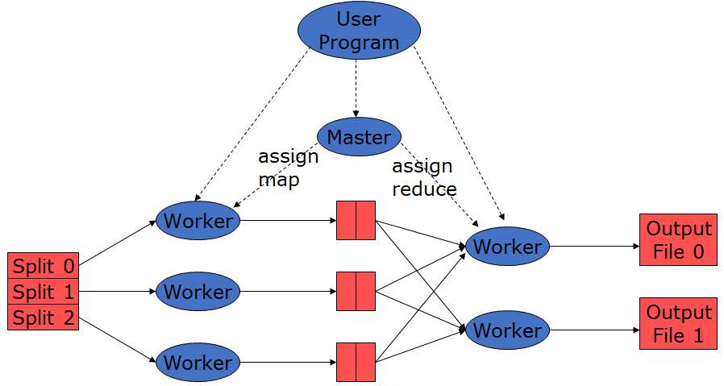
Distributed Execution Overview
Split the input file in M pieces.
Start up copies of the user’s program on the nodes.
The master assigns tasks to the workers.
Each map worker processes a piece of input data by running the user’s map function
The reduce worker processes each key using the user’s reduce function
The result is written to the global file system.
Input Files
Map Phase
Intermediate
Files
Reduce Phase
Output Files

Slide 20
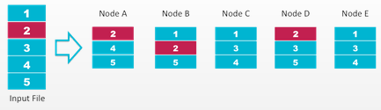
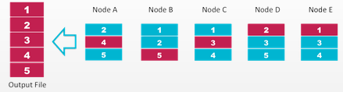
Distributed Data
Hadoop Distributed File System (HDFS) is a distributed file system that handles large data sets
One HDFS instance may consist of thousands of servers
HDFS has been built to detect faults and automatically recover
HDFS
Some elements of big data organized by HDFS services:
Volume - The amount of data generated.
Velocity - How fast data is generated and analyzed.
Variety - The type of data, this can be structured, unstructured, etc.

Slide 21
Spark
Spark platform designed based on Map-reduce framework for parallel processing and in-memory computation
Machine Learning library (MLlib) of Spark contains:
Classification: SVM, Naive Bayes, Random Forests, Neural Networks, ...
Regression: Linear Regression, ...
Clustering: K-means, ...
Dimensionality Reduction: PCA, LDA, ...
Association Rules: FP-growth, …

Slide 22
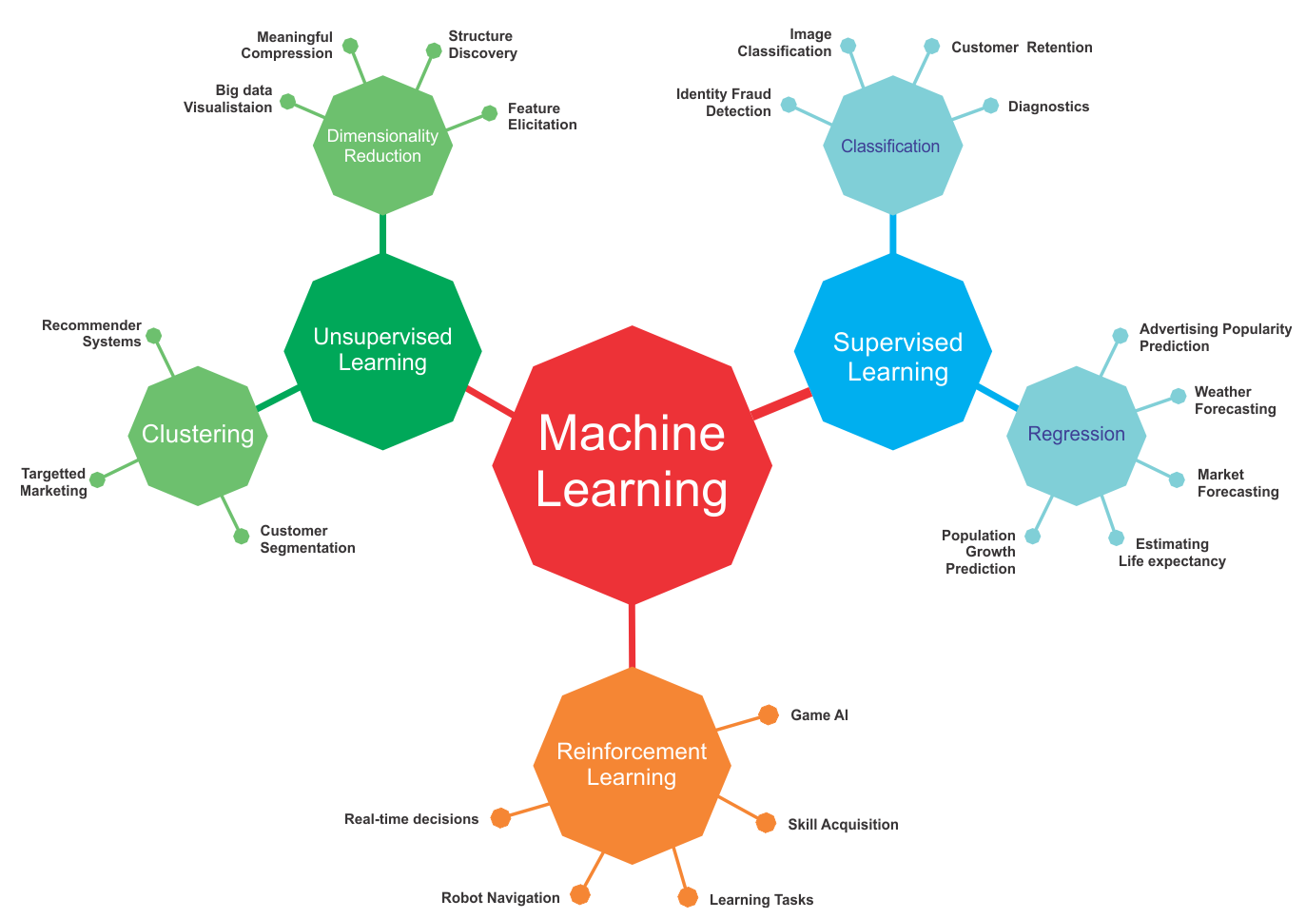
Machine Learning Models- Recap
Learning using unlabeled data
Learning using labeled data
Learning through Interactions with an environment

Slide 23
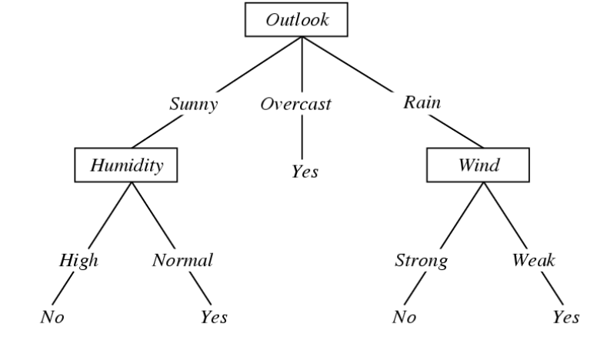
Decision Tree - Supervised
A decision tree is a hierarchical classification model that uses a tree structure and can be used to support decisions
Each internal node represent a test on one attribute (feature)
Each branch from a node represents a possible outcome of the test
Each leaf node represents a class label
Is weather condition suitable for playing tennis?

Slide 24
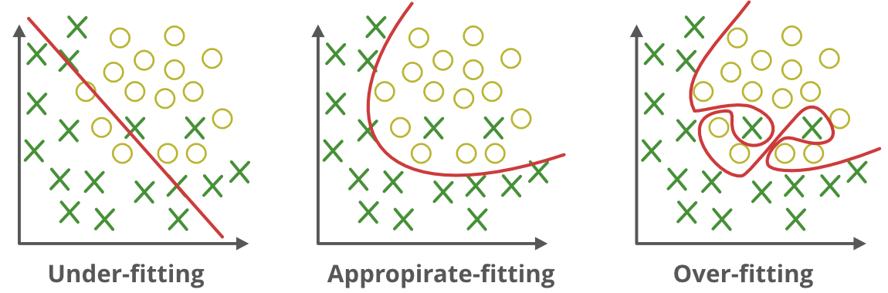
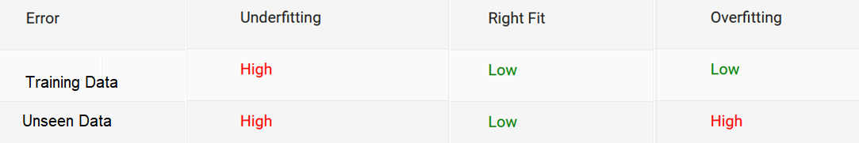
Overfitting
Our goal is not just to create a model that perform well on data used for training the model but also perform well for new / unseen data

Slide 25
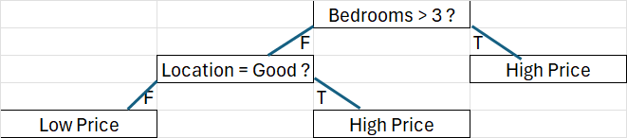
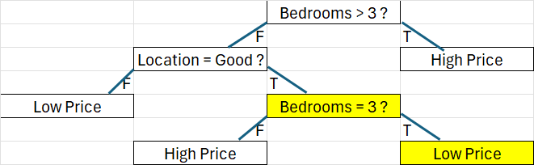
Decision Tree Overfitting- Example
Right Fit
Bedrooms | Location | Price
2 | Good | High Price
1 | Good | High Price
2 | Bad | Low Price
4 | Bad | High Price
4 | Good | High Price
1 | Bad | Low Price
3 | Good | Low Price
Accuracy = 86%
Overfitted
Accuracy = 100%

Slide 26
Avoid overfitting in Dtree
1. Reduce model complexity by stopping growth of the tree using constraints
Some of hyperparameters can be used as a constraint in decision trees are as follows:
•max_depth: maximum depth of decision tree
•min_sample_split: The minimum number of samples required to split an internal node:
•min_samples_leaf: The minimum number of samples required to be at a leaf node
•min_impurity_decrease: The minimum decrease in impurity by spliting
2. Grow full tree, then prune to reduce model complexity
Using Cost complexity pruning (CCP) or other pruning techniques

Slide 27
Linear Regression - Supervised
Fitting the data: finding the equation for the straight line (linear) that does the best job of modeling dependent variable as determined by independent variables.
b= ∑(xi−𝑥 ̄)(yi−y ̄) / ∑(xi−𝑥 ̄)2
𝑎=𝑦 ̄−𝑏𝑥 ̄

Slide 28
Underfitting
Bias is a systematic error that occurs due to inability of the model to fit training data. High bias indicates underfitting.
In a model with a low bias, average of error is near zero
In a model with a high bias, average of error is not zero and model is biased to higher or lower values

Slide 29
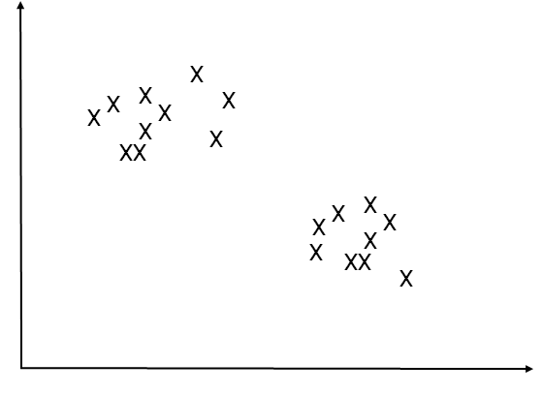
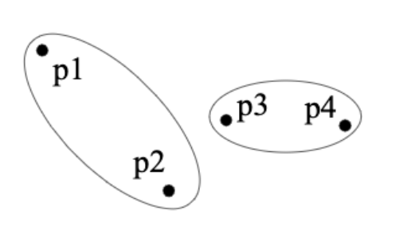
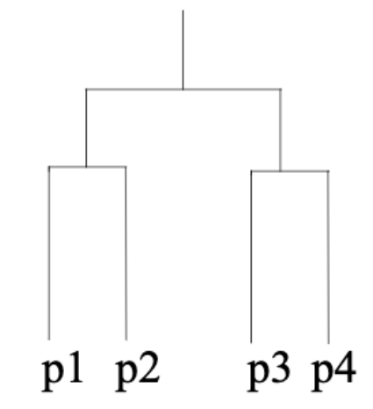
Clustering - Unsupervised
Given a set of data points, each described by a set of attributes (features), find clusters (groups) such that:
Inter-cluster (within a cluster) similarity is maximized (distance is minimum)
Intra-cluster (between clusters) similarity is minimized (distance is maximum)
Flat algorithms:
The resulting clusters are in a same level
Hierarchical algorithms:
The resulting clusters are in a hierarchical structure
Bottom-up (agglomerative)
Top-down (divisive)

Slide 30
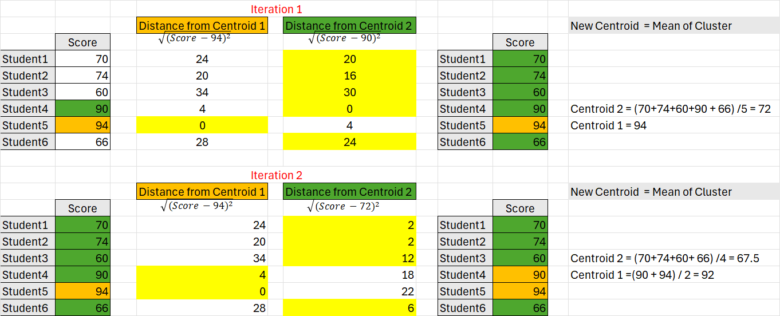
Sample of K-means with two cluster
Centroid 2
Centroid 1
Repeat iterations with new Centroids unless the change in Centroids is less than 1% (Convergence)

Slide 31
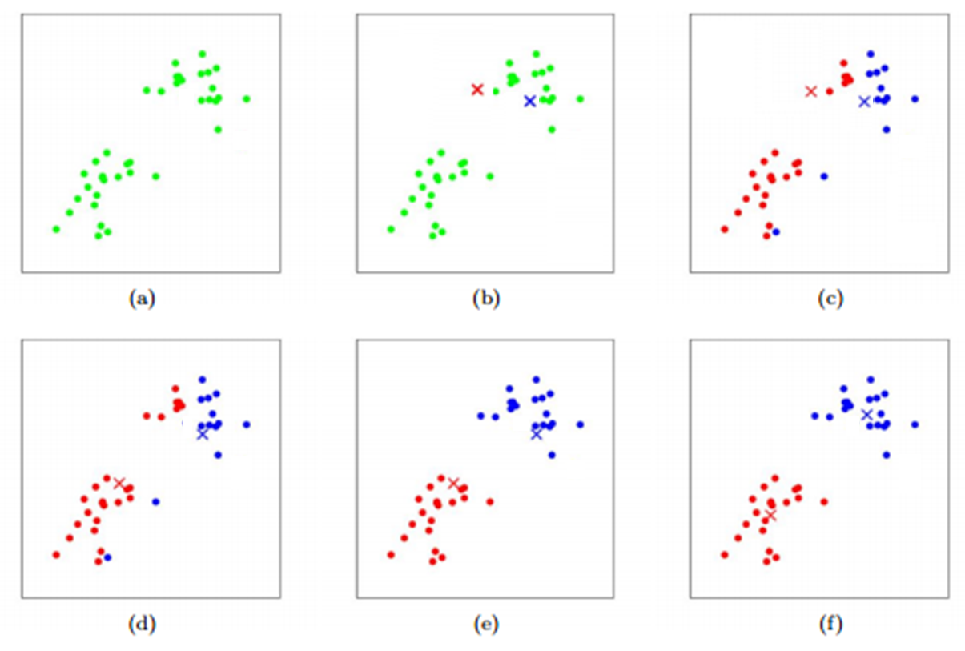
K-means Iterations - Example

Slide 32
Greedy Algorithms - Local Optimum

Slide 33
Hierarchical Clustering - Distance Types
Single linkage (nearest neighbor): In this method the distance between two clusters is determined by the distance of the two closest objects (nearest neighbors) in the different clusters.
Complete linkage (furthest neighbor): In this method, the distances between clusters are determined by the greatest distance between any two objects in the different clusters (furthest neighbors).
Average linkage: In this method, the distance between two clusters is calculated as the average distance between all pairs of objects in the two different clusters.
Other distances e.g., Ward linkage

Slide 34
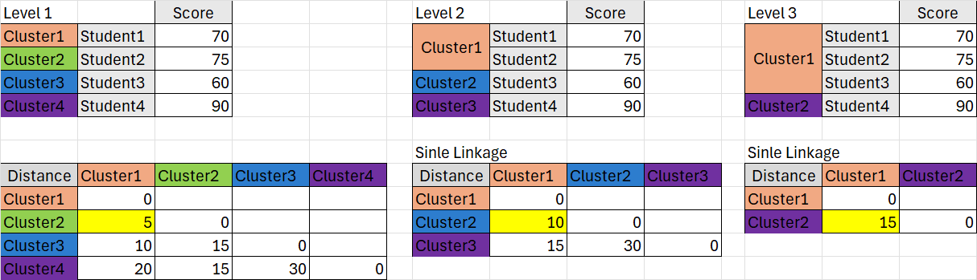
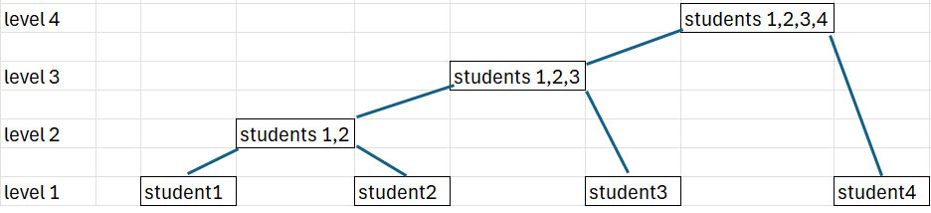
Bottom-up Hierarchical Clustering(Agglomerative)
Euclidean distance between ${Student}_{i}$ and ${Student}_{j}$ = $\sqrt{({Score}_{i}−{Score}_{j})^{2}}$

Slide 35
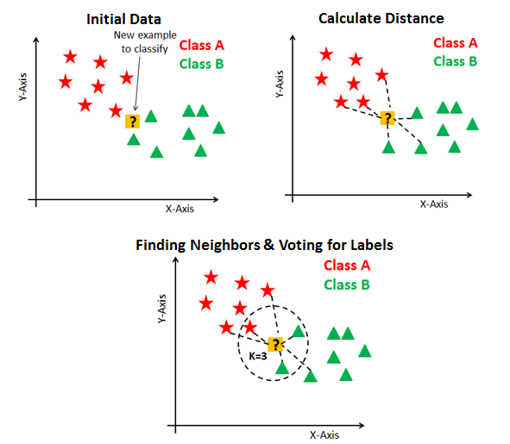
KNN Algorithm - Supervised
Get a test data point
Calculate distance between data points with training data points
Find k (hyper-parameter) nearest neighbors (less distance)
Assign a label based on labels of nearest neighbors (Majority Voting / Regression)
Repeat for other unlabeled data

Slide 36
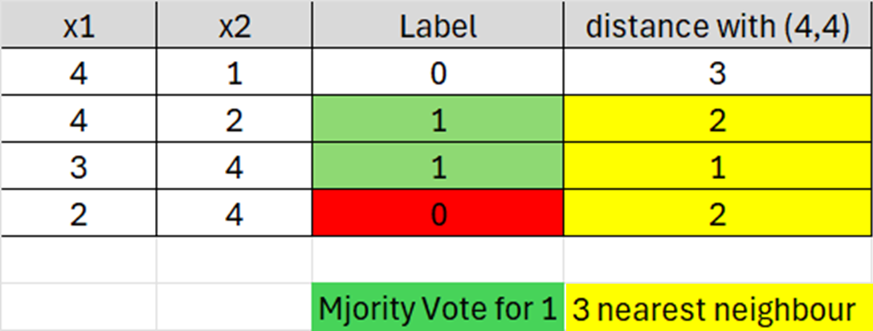
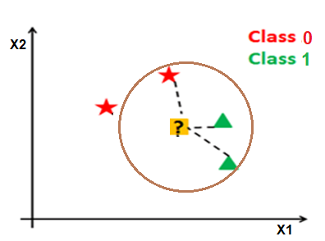
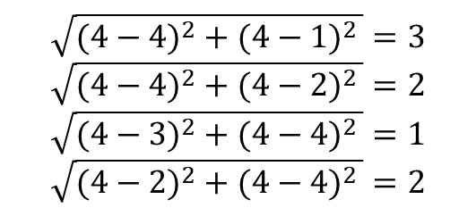
3-NN
Classification of a test data with features of x1=4 and x2=4 using a 3-NN:
Euclidean distance between a test and a train data$=\sqrt{(x_{1}test−x_{1}train)^{2}+(x_{2}test−x_{2}train)^{2 }}$
$$\sqrt{(4−4)^{2}+(4−1)^{2 }}=3$$
$$\sqrt{(4−4)^{2}+(4−2)^{2 }}=2$$
$$\sqrt{(4−3)^{2}+(4−4)^{2 }}=1$$
$$\sqrt{(4−2)^{2}+(4−4)^{2 }}=2$$

Slide 37
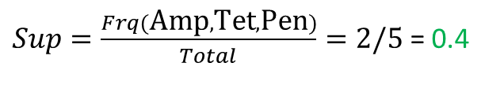
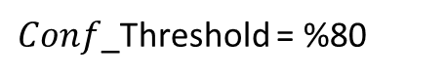
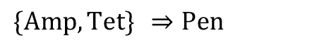
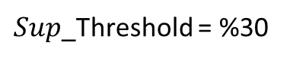
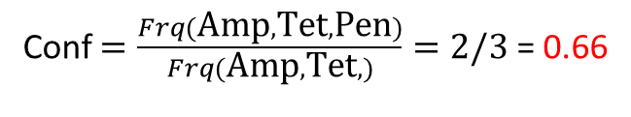
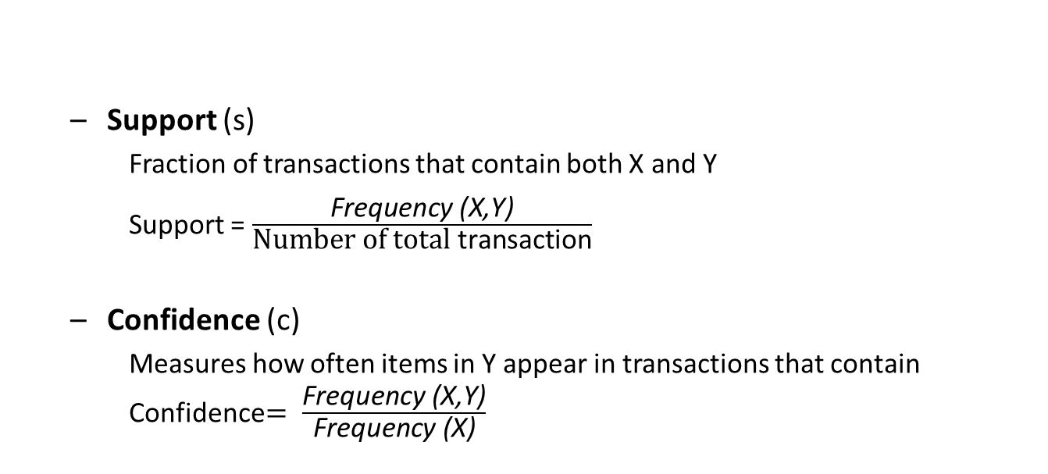
Association Rule Mining - Unsupervised
Association rules will predict the occurrence of an item based on the occurrences of other items in the transactional datasets
Why measure support?
Very low support rules can happen by chance
Why measure confidence?
Very low confidence rules are not reliable
Patient | Resistant against Antibiotics
Patient1 | Amp | Tet | Pen
Patient2 | Tet | Gen
Patient3 | Amp | Gen | Pen | Tet
Patient4 | Amp | Tet
Patient5 | Pen | Dox | Amp
Support (s)
Fraction of transactions that contain both X and Y
Support = $\frac{\text{F}\text{requency}\text{ (}\text{X}\text{,}\text{Y}\text{)}}{\text{Number} \text{of} \text{total} \text{transaction}}$
Confidence (c)
Measures how often items in Y appear in transactions that contain Confidence$= \frac{\text{Frequency}\text{ (}\text{X}\text{,}\text{Y}\text{)}}{\text{Frequency}\text{ (}\text{X}\text{)}}$
Example:
$$\{\text{Amp},\text{Tet}\} ⇒\text{Pen}$$
$Sup=\frac{Frq(\text{Amp},\text{Tet}, \text{Pen})}{Total}=2/5$ = 0.4
$Sup$_Threshold = %30
Conf $=\frac{Frq(\text{Amp},\text{Tet}, \text{Pen})}{Frq(\text{Amp},\text{Tet},)}=2/3$ = 0.66
$Conf$_Threshold = %80

Slide 38
Apriori Principle
Found to be Infrequent
All supersets would be infrequent

Slide 39
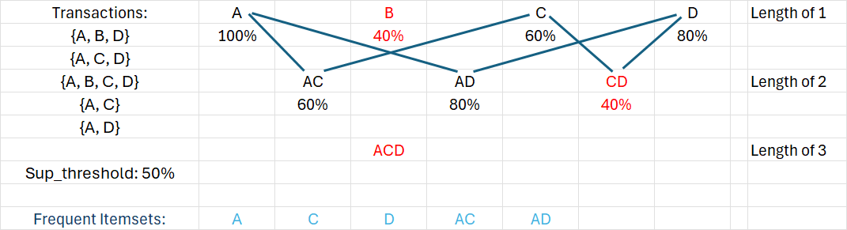
Frequent Itemsets using Apriori

Slide 40
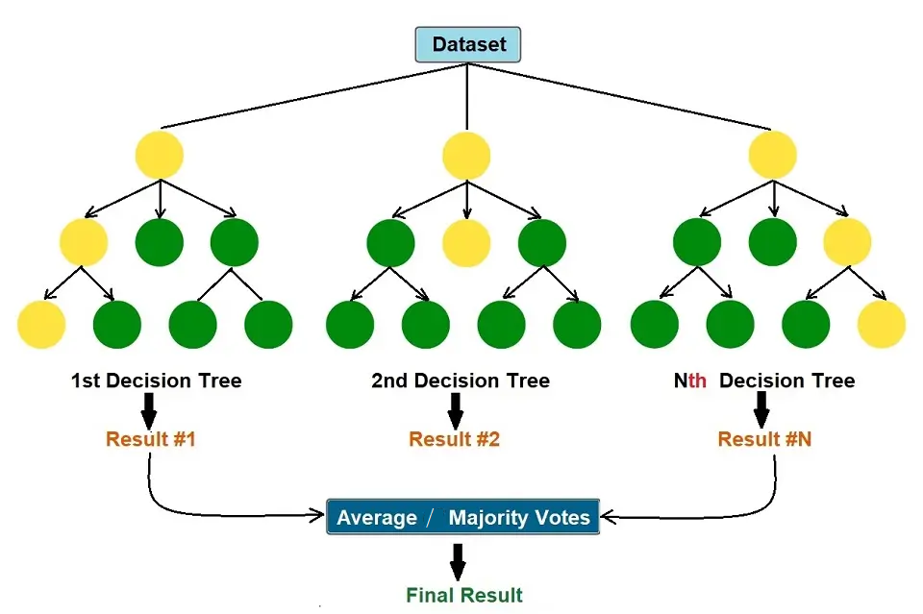
Ensembles- Supervised - Random Forests
Random forest is an extension of bagging that randomly selects subsets of features used in each data sample:
As in bagging, builds a number of decision trees on bootstrapped training samples
Each time a split in a tree is considered, a random sample of m predictors is chosen as split candidates from the full set of p predictors.

Slide 41
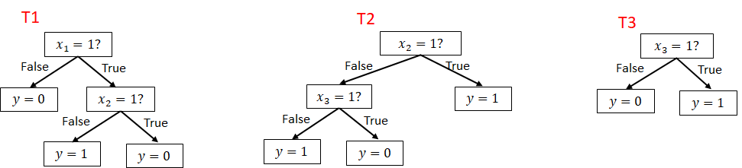
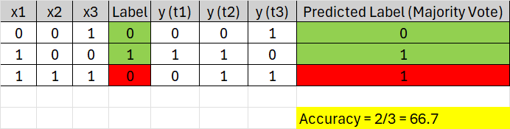
Random Forest using Majority Vote

Slide 42
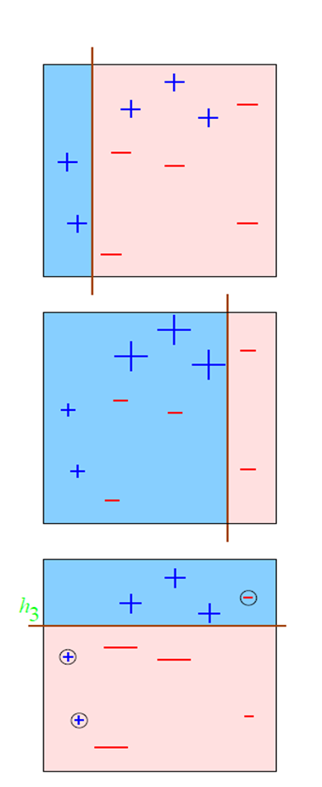
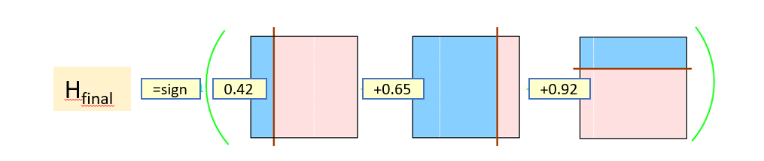
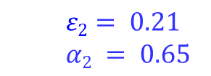
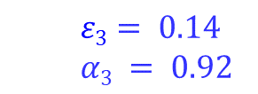
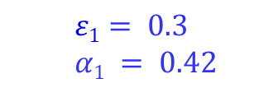
Boosting
Boosting refers to a general method of producing a strong predictor (accurate) by combining moderately inaccurate weak learners.
Weights models according to performance (Voting Power)
h₁
$$ε1= 0.3$$
$$α1 = 0.42$$
h₁
h₂
h₃
h₂
$$ε2= 0.21$$
$$α2 = 0.65$$
Suppose that a test data point :
Prediction by h1 = Plus
Prediction by h2 = Plus
Prediction by h3 = Minus
Then:
max(Plus: 0.42+ 0.65, Minus: 0.92) = max(Plus: 1.07, Minus: 0.92)
→ Prediction by Model: Plus
h₃
$$ε3= 0.14$$
$$α3 = 0.92$$

Slide 43
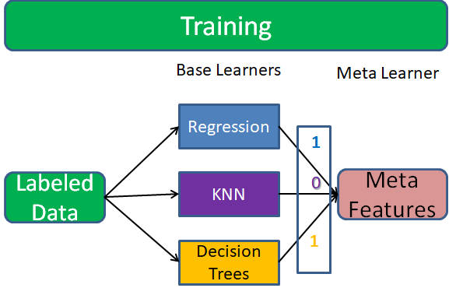
Stacking (Super Learner)
A heterogeneous ensemble consisting of different types of models (e.g., decision tree, neural network, etc.)
To combine predictions of base learners, do not just vote, instead, use a predictor model (meta learner)
The base learners are also called level-0 models
Meta learner is called level-1 model
Predictions of base learners are input to meta learner
Meta-learning refers to learning algorithms that learn from results of other learning algorithms.

Slide 44












Prediction on Test Data
Base Classifier – Naïve Bayes
Decision Tree as Meta Learner
$$NN=1?$$
False
True
$$y=0$$
$$NB=1?$$
False
True
$$KNN=1?$$
$$y=1$$
$$x_{1}$$ | $$x_{2}$$ | $$x_{3}$$ | Label (y) | $y$ (NB) | $y$ (KNN) | $y$ (NN)
0 | 1 | 1 | 0 | 0 | 1 | 1
False
True
Base Classifier - KNN
$$y=0$$
$$y=1$$
Base Classifier – Neural Network
$y$ (NB) | $y$ (KNN) | $y$ (NN) | Y
0 | 1 | 1 | ?

Slide 45

Naive Bayes - Supervised
Naïve Bayes classifier assigns the most probable class
Based on Bayes rule , most probable class is the class which maximize P(Cj) * π P(xi|Cj)
Most probable class $=\underset{c_{j}∈C}{\text{argmax}}P\left(c_{j}\right)∗ P\left(x_{1} | c_{j}\right)∗{P(x}_{2}\left|c_{j}\right)∗…∗P(x_{n}|c_{j})$
P(c_{j}): Can be estimated from the relative frequency of class $c_{j}$ in the training data
P $\left(x_{1} | c_{j}\right)$: Can be estimated from the relative frequency of $x_{1}$in class $c_{j}$ in the training data

Slide 46

Example - Training
P(x₁|c₁)
P(x₁|c₂)
P(C1) = P(Yes) = 9/14 P(C2) = P(No) = 5/14
 | OUTLOOK
 | Yes | No
Sunny | 2/9 | 3/5
Overcast | 4/9 | 0/5
Rainy | 3/9 | 2/5
Total | 9/9 | 5/5
P(Sunny|Yes)
P(Sunny|No)
P(Overcast|Yes)
P(Overcast|No)
P(Rainy|Yes)
P(Rainy|No)

Slide 47
Example – Predicting
Predict label for a datapoint: x = (Outlook = sunny, temperature = cool, Humidity = High, Wind = Strong)
P(Outlook = sunny | play = no) = 3/5
P(Temperature = cool | play = no) = 1/5
P(Humidity = high | play = no) = 4/5
P(Wind = strong | play = no) = 3/5
P(C2) = P(Play Tennis= no) = 5/14
C1 (Yes) → P(Yes) * [P(Sunny|Yes)*P(Cool|Yes)*P(High|Yes) *P(Strong|Yes)] = 2/9 *3/9 * 3/9 * 3/9 * 9/14 = 0.0206
C2 (No) → P(No) * [P(Sunny|No) *P(Cool|No) *P(High|No) *P(Strong|No)] = 3/5 * 1/5* 4/5 * 3/5 * 5/14 = 0.0053
arg max c(C1 = 0.0206, C2= 0.0053) = C1 → Play Tennis = Yes
P(Outlook = sunny | play = yes) = 2/9
P(Temperature = cool | play = yes) = 3/9
P(Humidity = high | play = yes) = 3/9
P(Wind = strong | play = yes) = 3/9
P(C1) = P(Play Tennis = yes) = 9/14

Slide 48

Markov Chain
The future state depends only on the present state, and not on any past states.
0.2
Drink Tea
Currently drinking coffee (Initial State) :
tea coffee water
[0 1 0]
What are probability of drinking tea for the fourth drink?
0.3
0.5
0.6
0.2
Drink Coffee
Drink Water
0.7
0.5

Slide 49
Markov Chain Inference - Example
Transition Matrix
Initial State (0)
0.2 | 0.6 | 0.2
0.3 | 0 | 0.7
0.5 | 0 | 0.5
A =
p0 =
0 | 1 | 0
Probabilities for First Drink (1)
0.2 | 0.6 | 0.2
0.3 | 0 | 0.7
0.5 | 0 | 0.5
p0 A =
p1 =
0 | 1 | 0
*
=
0.3 | 0 | 0.7
Probabilities for Second Drink (2)
0.2 | 0.6 | 0.2
0.3 | 0 | 0.7
0.5 | 0 | 0.5
p2 =
p1 A =
0.3 | 0 | 0.7
*
=
0.41 | 0.18 | 0.41
Probabilities for Third Drink (3)
0.2 | 0.6 | 0.2
0.3 | 0 | 0.7
0.5 | 0 | 0.5
p3 =
p2 A =
0.41 | 0.18 | 0.41
*
=
0.34 | 0.25 | 0.41
Probabilities for Fourth Drink (4)
0.2 | 0.6 | 0.2
0.3 | 0 | 0.7
0.5 | 0 | 0.5
p3 A =
p4 =
0.34 | 0.25 | 0.41
*
=
0.35 | 0.20 | 0.45

Slide 50


Markov-Decision Process in Reinforcement Learning
Markov Decision Process :
MDPs are the Markov chains with rewards as values. Agent get a value when it moves from one state to another by doing one action.
Rewards are the numerical values that the agent receives on performing some action at some state(s) in the environment. The numerical value can be positive or negative (penalty) based on the actions of the agent.
A policy is a probability distribution over the set of actions A, given the current state S. It gives the probability of picking an action a at state s.
In Reinforcement learning, the aim is picking the policy that maximizing the cumulative reward (all the rewards agent receives from the environment) instead of, the reward agent receives from the current state(also called immediate reward).

Slide 51
Dimensionality Reduction
Feature extraction:
creates a new set of features from the original features through some transformation .
Feature selection: chooses a subset of the original features.
Transformation could be linear or non-linear
K<D
Linear transformations are particularly attractive because they are analytically tractable.

Slide 52

Feature Selection
Independent of the model (e.g., dependency with the class)
Maximize accuracy of the model
Embed feature selection in the training of the model

Slide 53
Subset Selection in Wrapper - Forward
{x₂ , x₃ , x₁}
{x₂ , x₃, x₄}
AC(x₂, x₃ , x₁) > AC(x₂, x₃, x₄)
AC(x₂, x₃ , x₁) near AC(x₂, x₃)
Stops since improvement is not significant
AC(x₂, x₃, x₁) = 61% AC(x₂, x₃, x₄) = 60%
{x₂, x₁}
{x₂ , x₃}
{x₂ , x₄}
AC(x₂, x₃) > AC(x₂, x₁), AC(x₂, x₄)
AC(x₂, x₃) >> AC(x2)
AC(x₂,x₁) = 55% AC(x₂,x₃) = 60% AC(x₂,x₄) = 45%
{x₁} {x₂} {x₃} {x₄}
AC(x₂) > AC(x₁) , AC(x₂), AC(x₃)
AC(x₁) = 40% AC(x₂) = 50% AC(x₃) = 45% AC(x₄) = 30%
Ac (x): Accuracy of the model using feature(s) x

Slide 54



Feature Extraction - PCA vs LDA
PCA creates new variables which maximally explain the variance
LDA creates new variables which maximizes class separability
PCA is more effective than LDA for preserving information
LDA is more effective than PCA for classification

Slide 55
Feedforward Neural Networks - Supervised
Input Layer
Hidden Layer
Output Layer
BMI
30
I1
0.6
H1
Relu
0.5
0.3
O
Having Diabetes (1)
Not having Diabetes (0)
H2
Sigmoid
0.2
. Relu
0.8
I2
Glucose
140
-0.1
H1 = Relu (30*0.6 + 140*0.2 ) = Relu (46) = 46
H2 = Relu (30*0.3 + 140*-0.1 ) = Relu (-5) = 0
O = Sigmoid (46*0.5 + 0*0.8) = Sigmoid (23) = 0.99
0.99 > 0.5 → Output = 1 (Having Diabetes)
Relu (x) = Max(x,0)

Slide 56

Training Neural Network
Each training input is loaded into the neural network in a process called forward propagation.
Once the model has produced an output, this predicted output is compared against the given real output (target) in a process called backpropagation, the weights of the model are then adjusted to produce a result closer to the target output.
forward propagation.
Backward propagation

Slide 57

CNN - Supervised
CNNs contains multiple convolutional layers
Each Layer contains multiple filters to extract different features
Multiple Layers of feature extraction are required to extract complex features by combining outputs from last layers

Slide 58

Typical CNN Architecture
First Stage: Pooling and convolutions can repeat inside CNNs:
Various filters (convolutions) detect Various features (in different levels)
Activation function (mostly ReLU) is used to deactivate non-pattern nodes (negative values) also to provide non-linearity
Pooling applies to reduce dimensions and add some translation invariance
Second Stage: Classification
Outputs of last convolutional layer is flattened
Fully connected layers handles classification process

Slide 59

GAN - Semi Supervised
Generative Adversarial Networks are an approach to generative modeling using deep learning methods, such as convolutional neural networks. A generative adversarial network (GAN) has two competing models in a zero-sum game :
The generator learns to generate plausible fake data.
The discriminator learns to distinguish the generator's fake data from real data.

Slide 60

Recurrent Networks offer a lot of flexibility:
Recurrent Neural Networks
RNNs are suited for time series as they leverage the sequential nature of the data and learn from temporal dependencies.
e.g. Image Captioning
image -> sequence of words
e.g. Stock Prediction
seq of stock prices -> future stock price
e.g. Machine Translation
seq of words -> seq of words

Slide 61


Encoder Decoder - Translation Example
Encoder: Trained on the source language sentences to takes an input sentence (sequence of words) in the language and generates a contextualized representation of the sentence.
Decoder: Trained on the target language sentences to autoregressively create statements based on the input context
trained on sentences in first language
trained on sentences in second language
states of previous nodes (short memory)
context (long memory)

Slide 62

Transfer Learning - Model Fine-tuning
Training a model by source data, then fine-tune the model by target data
Source data: A large amount of labeled data
Target data: A small amount of labeled data
e.g., in CNN:
Source data: images of different objects
Target data: images of a specific object

Slide 63



Zero-shot Learning
The model is trained to extract features using samples in the training dataset and predict classes, even classes have never seen during the training, based on semantic embeddings.
1
0
0
1
1
0
 | Env | Neg | Spike | …
SARS | 1 | 0 | 0
Covid | 1 | 0 | 1
Flu | 1 | 1 | 0
…
Output of model:
SARS Flu
Env
Neg
Spike
Env
Neg
Spike
CNN
CNN
Training
Env=1 | Neg=0 | Spike=1
Label: ?
Label: SARS
Label: Flu
Unseen data during training

Slide 64

Machine Learning
“Machine Learning: Field of study that gives computers the ability to learn without being explicitly programmed.”
Arthur Samuel

